Slide 1
From Meta Learning to Zero-Shot
姜修齐

Slide 2
Meta Learning
Machine Learning
What is Meta Learning?
Faster
More flexible
More autonomous
Less dependence of data
Use previous knowledge
Deep Learning
Deep Reinforcement Learning
Deep Meta Learning

Slide 3
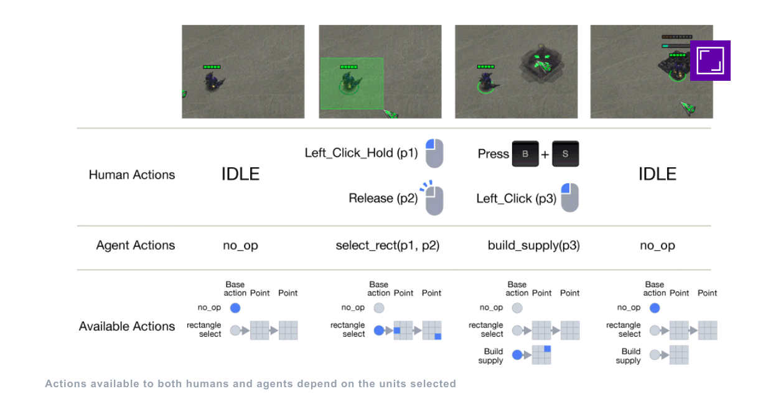
Why Meta Learning?

Slide 4
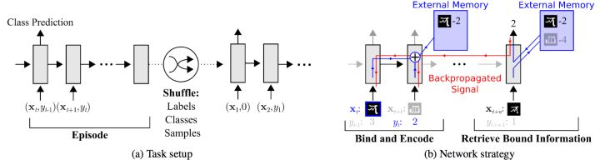
Different Accesses to Meta Learning
Memory replay
Santoro, Adam, Bartunov, Sergey, Botvinick, Matthew, Wierstra, Daan, and Lillicrap, Timothy.
Meta-learning with memory-augmented neural networks. 2016

Slide 5
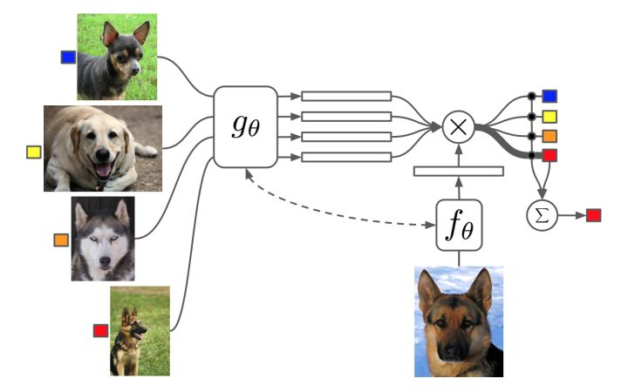
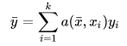
Different Accesses to Meta Learning
Feature extracting
Vinyals, Oriol, Blundell, Charles, Lillicrap, Tim, Wierstra, Daan, et al. Matching networks for one shot learning. 2016

Slide 6
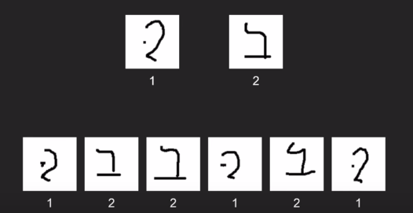

One-Shot Learning

Slide 7
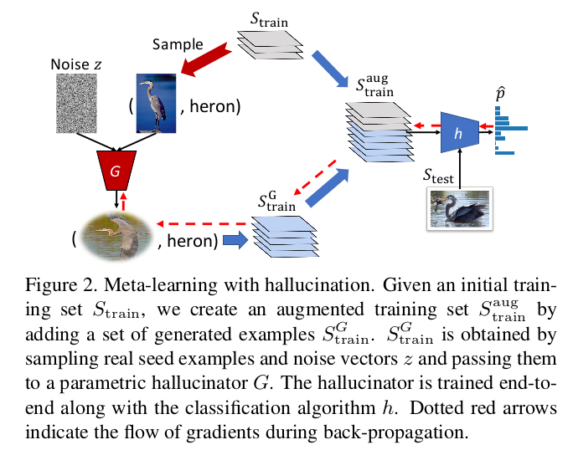
Low-Shot Learning from Imaginary Data

Slide 8
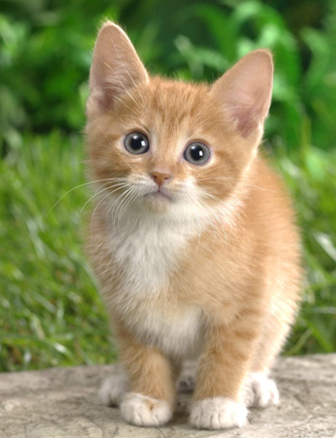
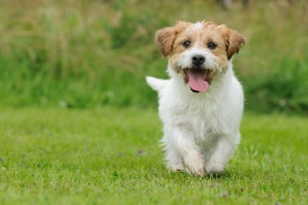
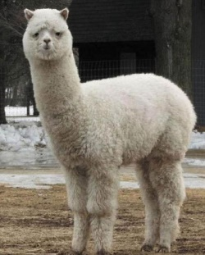
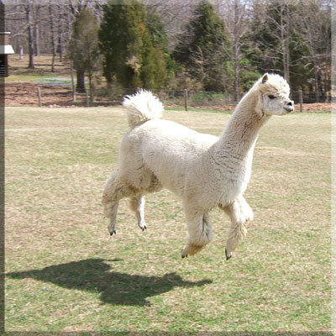
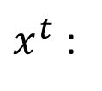
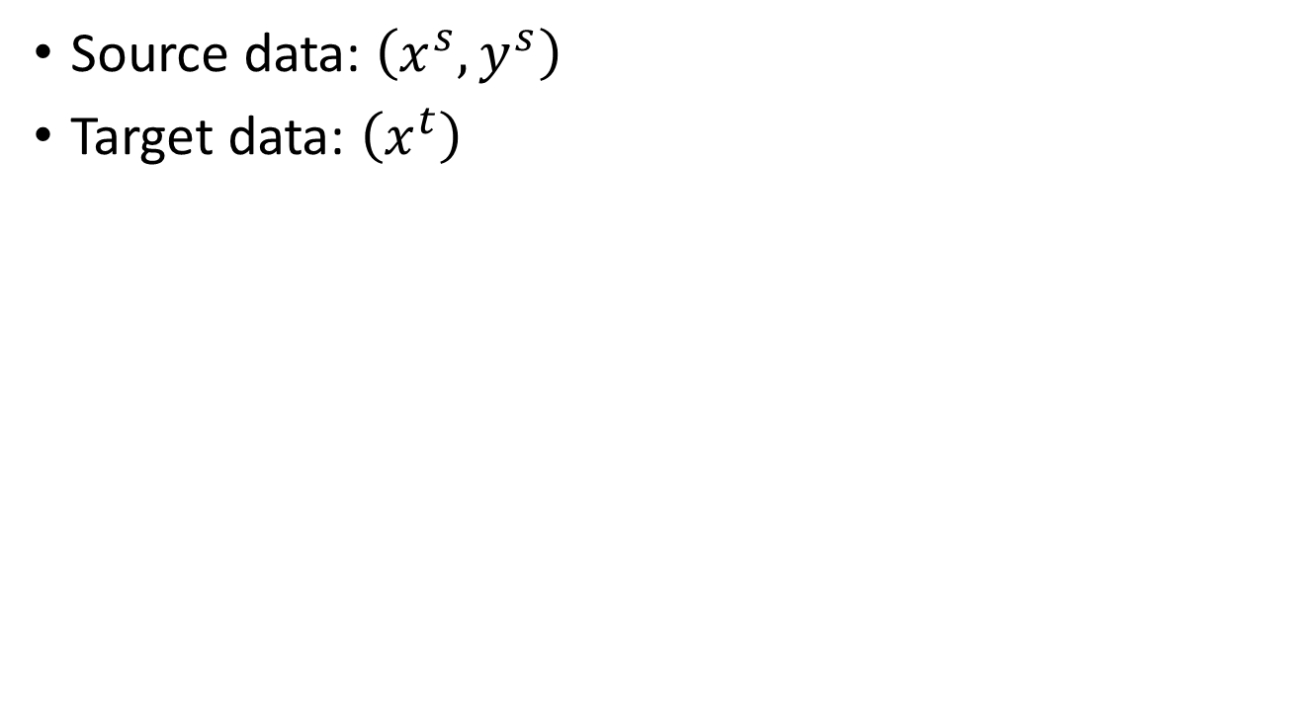
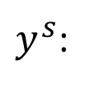
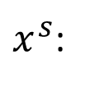
Zero-shot Learning
http://evchk.wikia.com/wiki/%E8%8D%89%E6%B3%A5%E9%A6%AC
Training data
Source data: $\left(x^{s},y^{s}\right)$
Target data: $\left(x^{t}\right)$
Different tasks
Testing data
$x^{s}$:
$x^{t}$:
……
$y^{s}$:
……
cat
dog
In speech recognition, we can not have all possible words in the source (training) data.

Slide 9
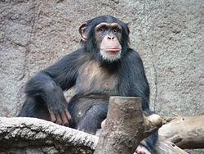

Zero-shot Learning
Representing each class by its attributes
Training
1
0
0
1
1
1
Database
furry
4 legs
tail
furry
4 legs
tail
attributes
 | furry | 4 legs | tail | …
Dog | O | O | O
Fish | X | X | O
Chimp | O | X | X
…
NN
NN
class
sufficient attributes for one to one mapping

Slide 10
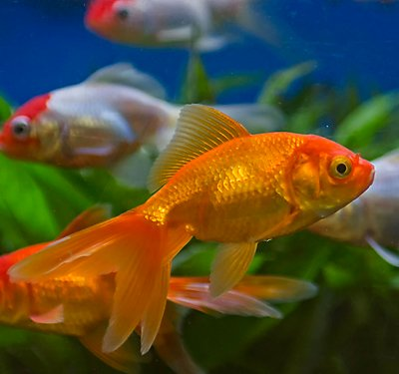
Zero-shot Learning
Representing each class by its attributes
Testing
Find the class with the most similar attributes
0
0
1
furry
4 legs
tail
attributes
 | furry | 4 legs | tail | …
Dog | O | O | O
Fish | X | X | O
Chimp | O | X | X
…
NN
class
sufficient attributes for one to one mapping

Slide 11

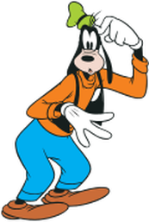

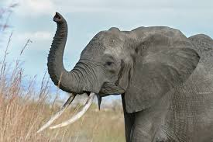
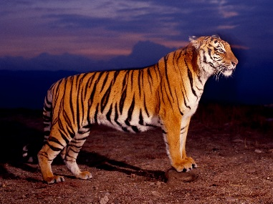
Transfer Learning
http://weebly110810.weebly.com/396403913129399.html
http://www.sucaitianxia.com/png/cartoon/200811/4261.html
Dog/Cat
Classifier
cat
dog
Data not directly related to the task considered
elephant
tiger
dog
cat
Similar domain, different tasks
Different domains, same task

Slide 12
Transfer Learning
Source Data (not directly related to the task)
labelled
unlabeled
Self-taught learning
Fine-tuning
labelled
Multitask Learning
Target Data
Domain-adversarial training
unlabeled
Self-taught Clustering
Zero-shot learning

Slide 13

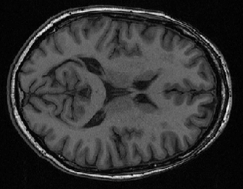


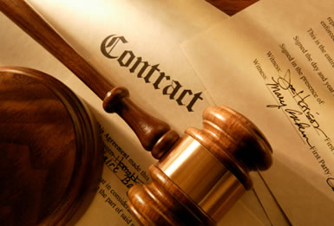
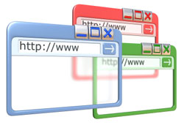
Why?
vast and growing number of categories
collecting and annotating examples is impossible especially deep learning scale
new categories always emerging
Task Considered
Data not directly related
Speech
Recognition
English
Russian
Chinese
……
Image Recognition
Medical
Images
Text
Analysis
Specific domain
Webpages
Notes:
Transfer
Self-taught

Slide 14

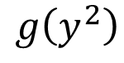
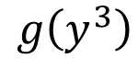
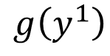
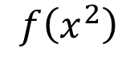
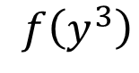
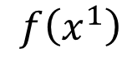
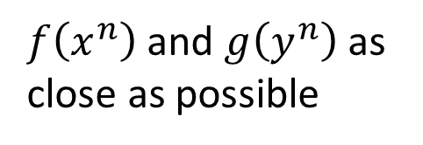
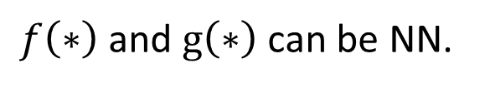
Zero-shot Learning
$f\left(∗\right)$ and $g\left(∗\right)$ can be NN.
Training target:
$f\left(x^{n}\right)$ and $g\left(y^{n}\right)$ as close as possible
Attribute embedding
x²
y¹ (attribute of chimp)
y² (attribute of dog)
x¹
$$f\left(x^{2}\right)$$
$$g\left(y^{2}\right)$$
$$f\left(x^{1}\right)$$
$$g\left(y^{1}\right)$$
y³ (attribute of Grass-mud horse)
$$g\left(y^{3}\right)$$
$$f\left(y^{3}\right)$$
x³
Embedding Space

Slide 15
Zero-shot Learning
What if we don’t have database
Attribute embedding + word embedding
y¹ (attribute of chimp)
x²
V(chimp)
y² (attribute of dog)
V(dog)
x¹
$$f\left(x^{2}\right)$$
$$g\left(y^{2}\right)$$
$$f\left(x^{1}\right)$$
$$g\left(y^{1}\right)$$
y³ (attribute of Grass-mud horse)
$$g\left(y^{3}\right)$$
$$f\left(y^{3}\right)$$
V(Grass-mud_horse)
x³
Embedding Space

Slide 16
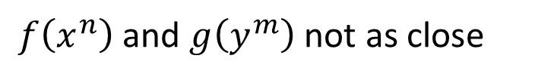
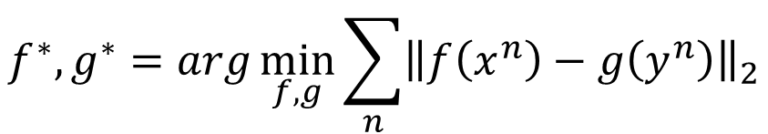
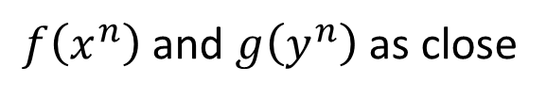
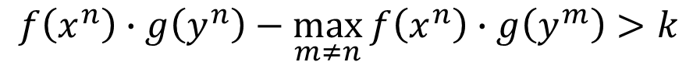
Zero-shot Learning
$$f^{∗},g^{∗}=arg\min_{f,g}{\sum_{n}{{\left\|f\left(x^{n}\right)−g\left(y^{n}\right)\right\|}_{2}}}$$
Problem?
$$f^{∗},g^{∗}=arg\min_{f,g}{\sum_{n}{max\left(0,k−f\left(x^{n}\right)∙g\left(y^{n}\right)+\max_{m≠n}{f\left(x^{m}\right)∙g\left(x^{m}\right)}\right)}}$$
$$f^{∗},g^{∗}=arg\min_{f,g}{\sum_{n}{max\left(0,m−f\left(x^{n}\right)∙g\left(x^{n}\right)+\max_{m≠n}{f\left(x^{n}\right)∙g\left(y^{m}\right)}\right)}}$$
Margin you defined
Zero loss:
$$k−f\left(x^{n}\right)∙g\left(y^{n}\right)+\max_{m≠n}{f\left(x^{n}\right)∙g\left(y^{m}\right)}<0$$
$$f\left(x^{n}\right)∙g\left(y^{n}\right)−\max_{m≠n}{f\left(x^{n}\right)∙g\left(y^{m}\right)}>k$$
$f\left(x^{n}\right)$ and $g\left(y^{n}\right)$ as close
$f\left(x^{n}\right)$ and $g\left(y^{m}\right)$ not as close

Slide 17
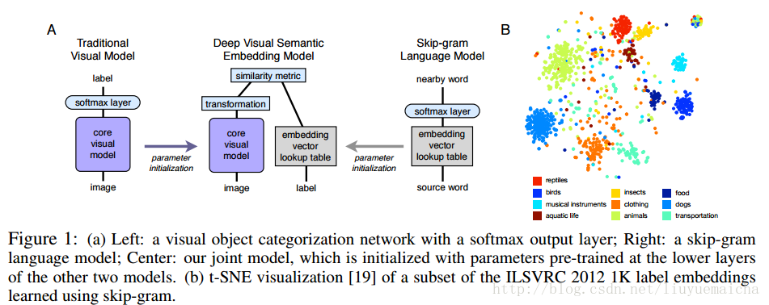
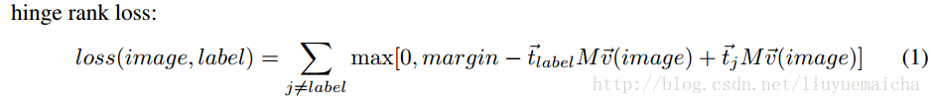
Zero-shot Learning
Frome A, Corrado G S, Shlens J, et al.
DeViSE: a deep visual-semantic embedding model

Slide 18
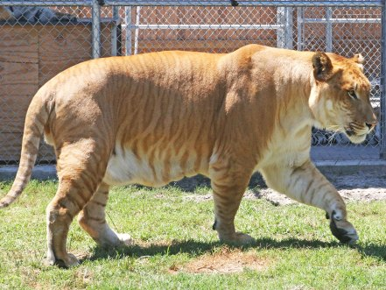
Zero-shot Learning
Zero-Shot Learning by Convex Combination of Semantic Embeddings
Mohammad Norouzi, Tomas Mikolov, Samy Bengio, Yoram Singer, Jonathon Shlens, Andrea Frome, Greg S. Corrado, Jeffrey Dean
lion
tiger
V(tiger)
0.5
0.5
Find the closest word vector
V(liger)
NN
0.5V(tiger)+0.5V(lion)
V(lion)
Only need off-the-shelf NN for ImageNet and word vector

Slide 19
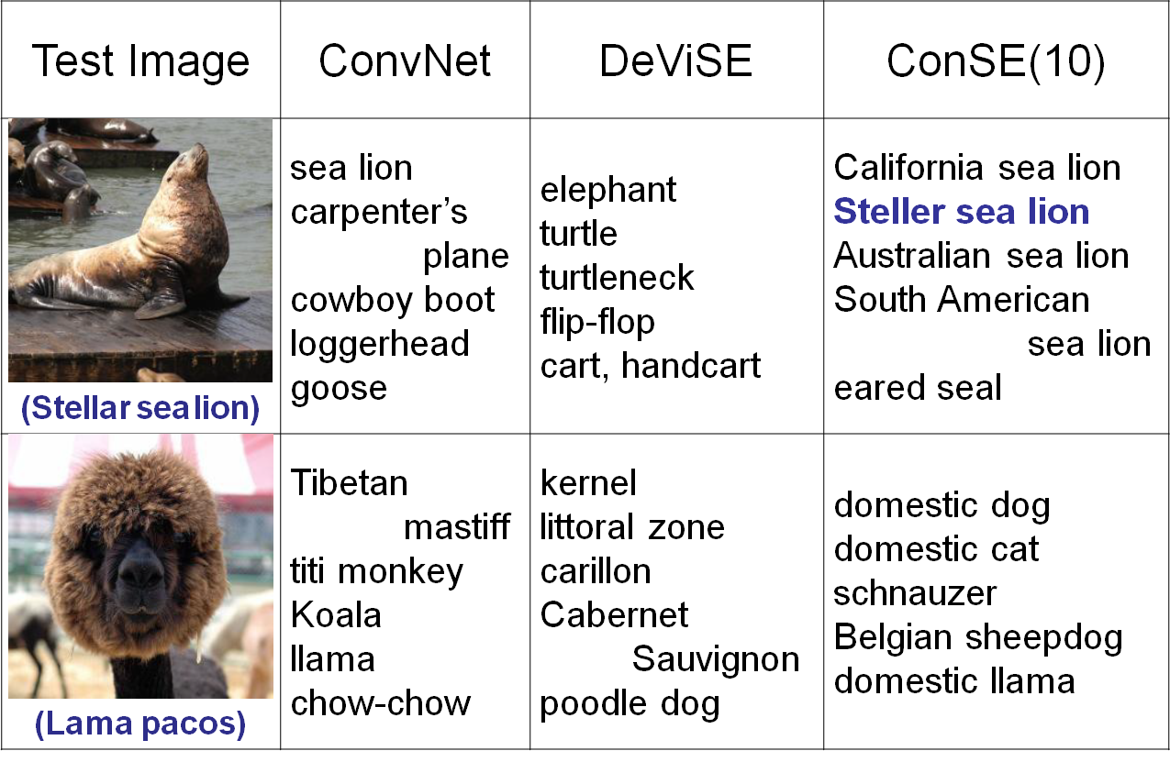
https://arxiv.org/pdf/1312.5650v3.pdf
Notes:
高領毛衣

Slide 20
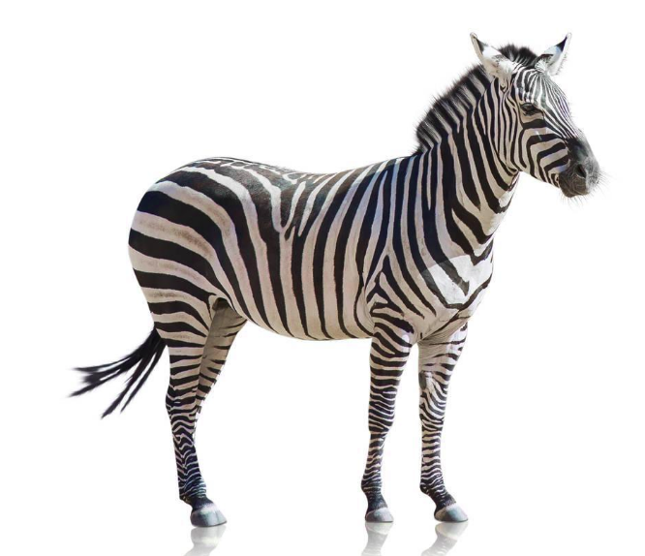
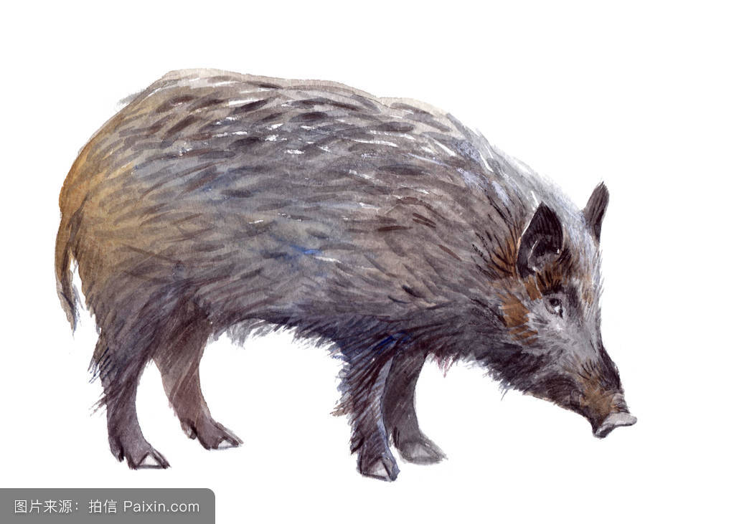
Domain Shift in Zero-shot Learning
x
x’
When doing embedding, we lose features
s: ..., (tail:) 1, ...
The dimension of feature x is far more than semantic s

Slide 21
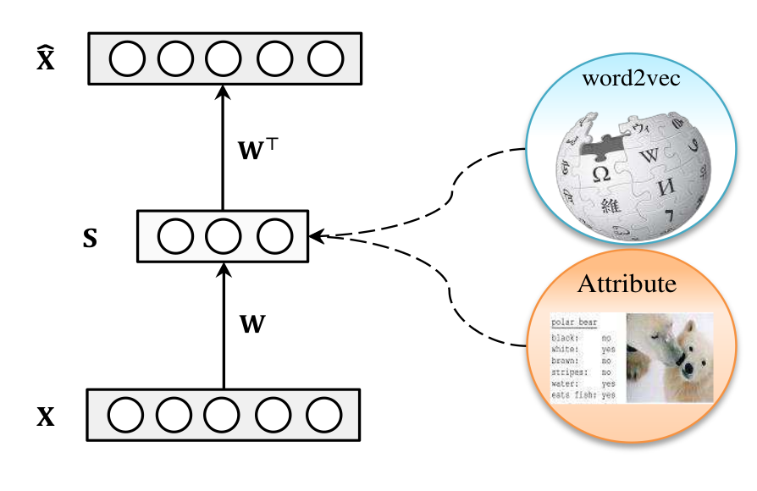
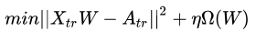
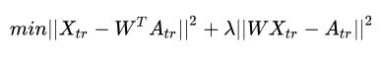
Semantic Auto-Encoder Model
ridge regression:
add auto-encoder:
Semantic Autoencoder for Zero-Shot Learning

Slide 22
Another Way to Deal With Domain Shift
Training data
Source data: $\left(x^{s},y^{s}\right)$
Target data: $\left(x^{t}\right)$
Same task, mismatch
Testing data
with label
without label
【Adversarial Discriminative Domain Adaptation
Eric Tzeng, Judy Hoffman, Kate Saenko, Trevor Darrell】

Slide 23
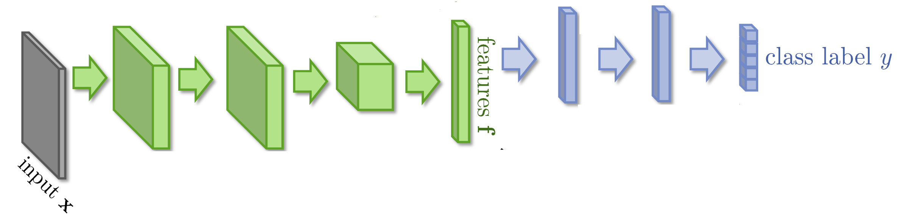


Domain-adversarial training

Slide 24
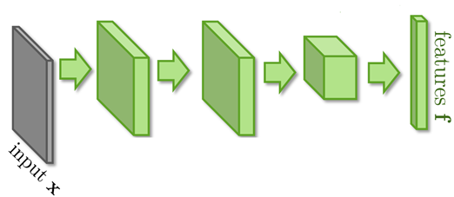
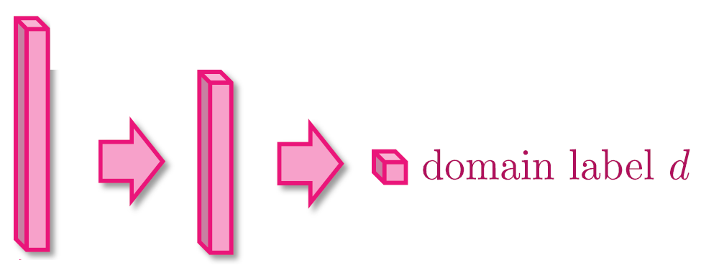


Domain-adversarial training
Similar to GAN
feature extractor
Too easy to feature extractor ……
Domain classifier

Slide 25
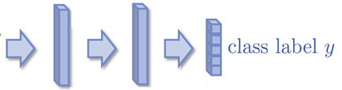
Domain-adversarial training
Maximize label classification accuracy + minimize domain classification accuracy
Maximize label classification accuracy
feature extractor
Label predictor
Domain classifier
Not only cheat the domain classifier, but satisfying label classifier at the same time
Maximize domain classification accuracy
This is a big network, but different parts have different goals.

Slide 26
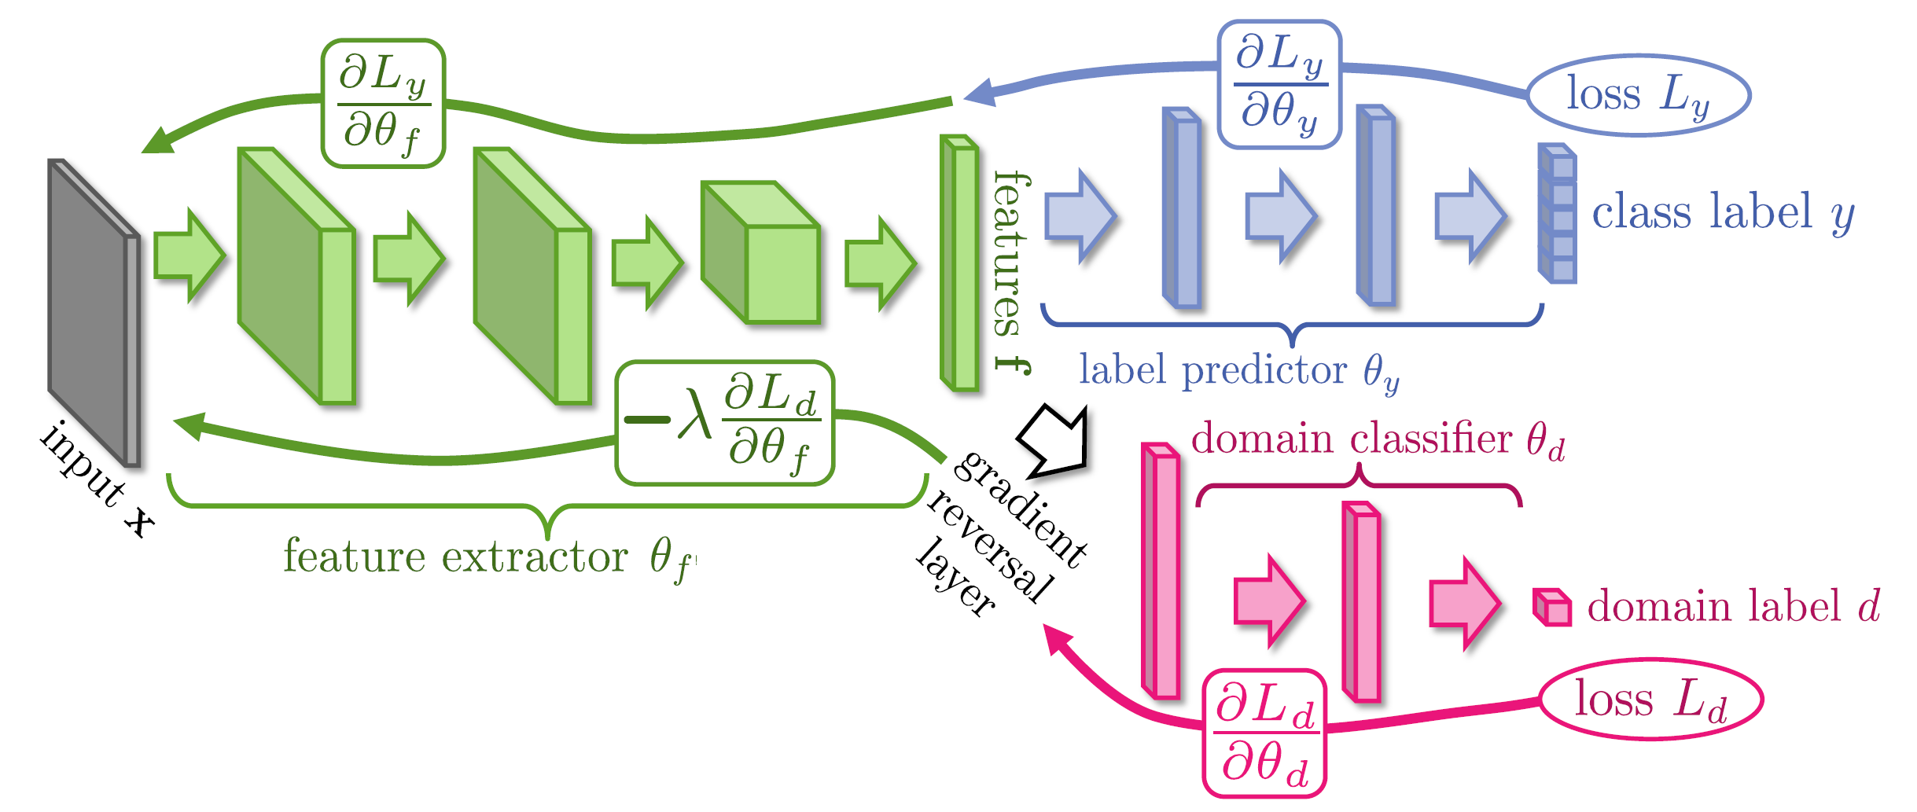
Domain-adversarial training
Domain classifier fails in the end
It should struggle ……
Yaroslav Ganin, Victor Lempitsky, Unsupervised Domain Adaptation by Backpropagation, ICML, 2015
Hana Ajakan, Pascal Germain, Hugo Larochelle, François Laviolette, Mario Marchand, Domain-Adversarial Training of Neural Networks, JMLR, 2016

Slide 27
Domain-adversarial training
Yaroslav Ganin, Victor Lempitsky, Unsupervised Domain Adaptation by Backpropagation, ICML, 2015
Hana Ajakan, Pascal Germain, Hugo Larochelle, François Laviolette, Mario Marchand, Domain-Adversarial Training of Neural Networks, JMLR, 2016

Slide 28
Thanks!

